Slide 1
Quick Sort
by Ghulam Mustafa

Slide 2
What is Quick sort
Quicksort is a fast, divide-and-conquer sorting algorithm that works by selecting a "pivot" element and partitioning the other elements into two sub-arrays: one with elements less than the pivot and one with elements greater than the pivot.
The algorithm then recursively sorts these sub-arrays until the entire array is sorted. It is known for its efficiency

Slide 3
Why is Quick Sort Important?
• Very fast for large datasets
• Efficient memory usage (in-place)
• Often faster than merge/heap sort

Slide 4
How Quick Sort Works
1. Choose a pivot
2. Partition array into smaller and larger elements
3. Recursively sort left and right parts
4. Combine results

Slide 5
Methodology

Slide 6
Start=LB=1 End= ub=10
Pivot=d[lb]
while(start<end) { start++; end--;
If(start<end) {swap(d[start,d[end]} {swap(d[end],d[lb]}
6
4
9
2
5
8
1
3
10
7
Swap
6
4
3
2
5
8
1
9
10
7
Swap
6
4
3
2
5
1
8
9
10
7
Swap
1
4
3
2
5
6
8
9
10
7

Slide 7
1
4
3
2
5
6
8
9
10
7
1
4
3
2
5
6
7
8
10
9
2
3
4
5
7
8
9
10
2
3
4
5
9
10
2
3

Slide 8
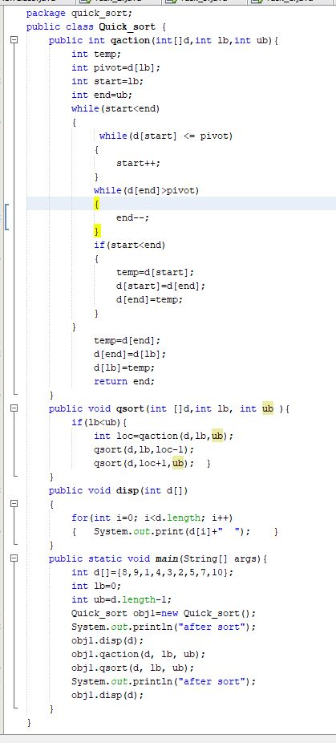
Program

Slide 9
Time Complexity
Best: O(n log n)
Average: O(n log n)
Worst: O(n²)

Slide 10
Space Complexity
• O(log n) due to recursion
• In‑place sorting

Slide 11
THANK YOU

